Slide 1
INTELLIGENCE MODULE-2
Cognitive process of reasoning and understanding
Intelligence is defined as….
Adopt to a variety of situation
learn,
Employ abstract concepts
Property of the mind---to reason, to plan, to solve problems etc.
General capabilities and several specific abilities

Slide 2
KINDS OF INTELLIGENCE:
Single unitary factor or a combination of multiple components.
Single factor-g factor
Other factors called s factors
Fluid intelligence-processing cap,reasoning and memory
crystallized intelligence– gathering of info,skill and strategies- exp

Slide 3
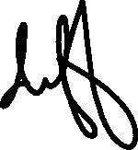

























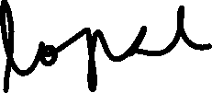
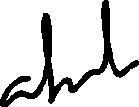






Theories of intelligence
3
1)Spearman’s g factor
2)Gardner’s multiple intelligence theory
3)Sternberg’s Triarchic theory

Slide 4
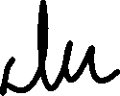















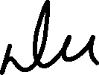


























Slide 5


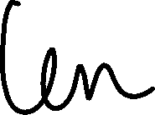
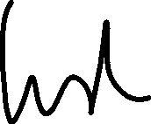
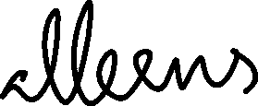





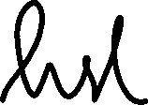





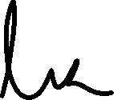


Slide 6
3. Sternberg’s triarchic theory
3
1.analytical intelligence-pb-sub pb-analysis-finding solutions
2.creative intelligence—deal with new and diff concepts
3.practical intelligence--

Slide 7











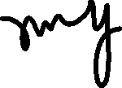






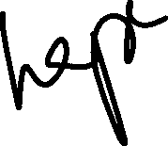







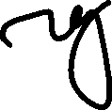

















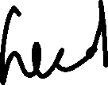





Measurement of intelligence
1)Binet and Simon test
2 )Stanford-Binet scale
3) The Wechsler scale
4)Group tests

Slide 8








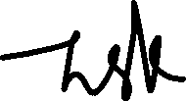














Binet and Simon test

Slide 9



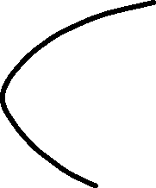











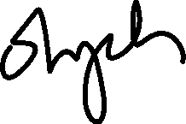









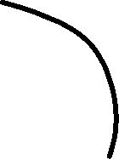


Slide 10













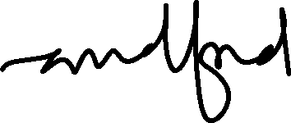



Slide 11





Type of reasoning Eg; of tests
Verbal
Vocabulary
Absurdities
Intelligence
Quantitative
Quantitative tests
Number series
Abstarct visual
Paper folding
copying
Fig:Stanford-Binet Test
Short-term memory
Memory for sentences
Memory for order in which familiar objects are presented

Slide 12



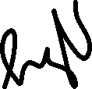

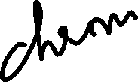
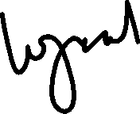


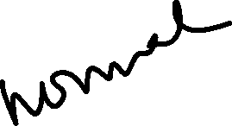

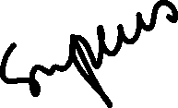







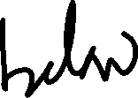
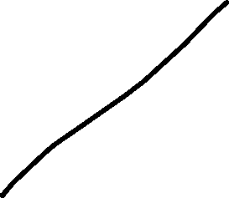
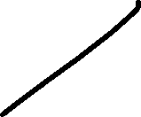

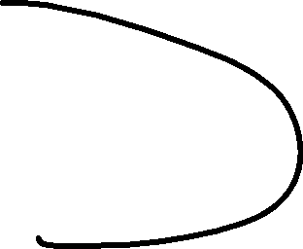








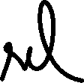
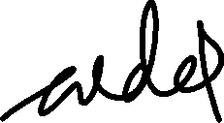


Slide 13
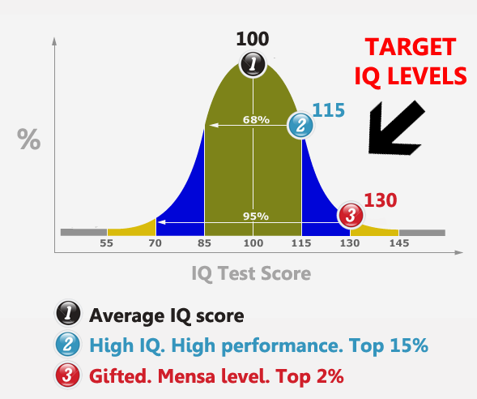
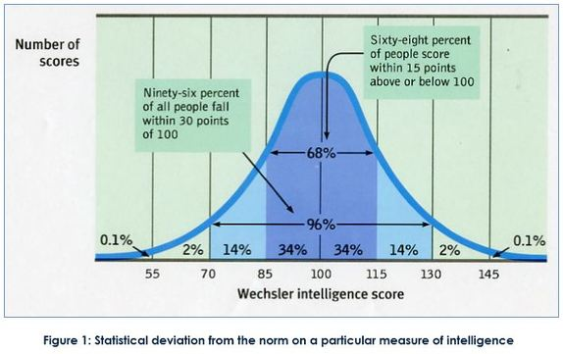
BELL-SHAPED CURVE OF INTELLIGENCE

Slide 14
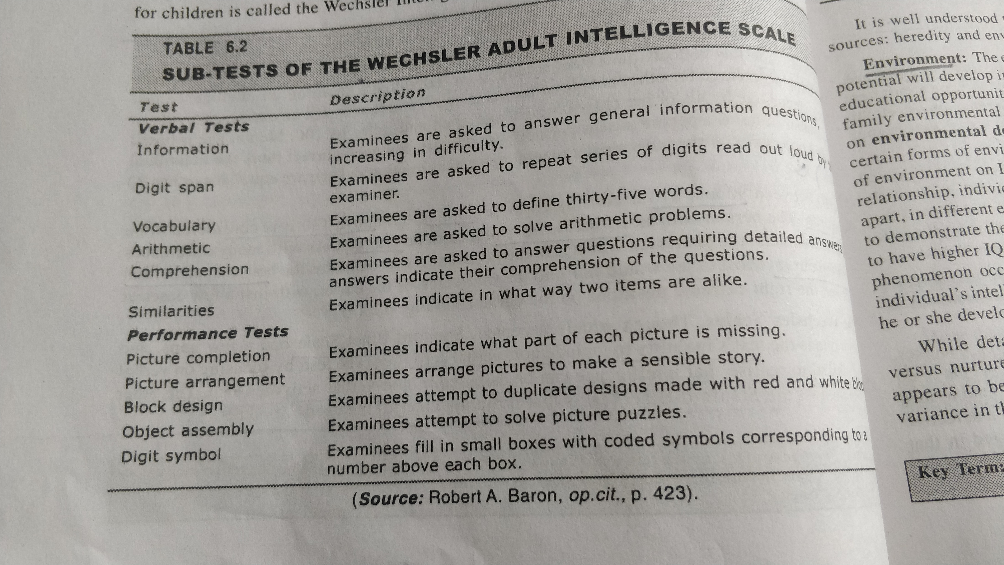

Slide 15









